Slide 1
IT204F Project Proposal
By: Seng Hong, Yi Ting, Ashley Ann, Gui Cheng

Slide 2
Table Content
1
Background
4
Methodology
2
Current Problem
5
References
3
Solution
6
QNA Session

Slide 3
Background
1

Slide 4
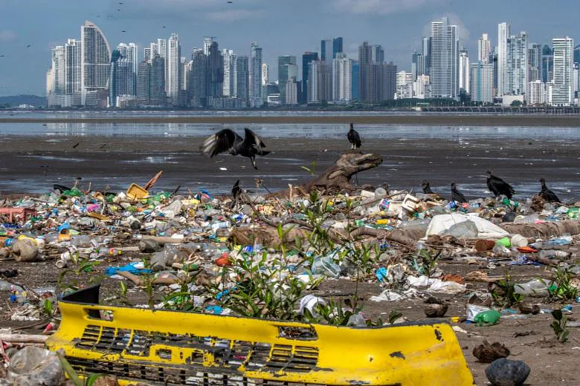
Background
Over 300 tonnes of plastic have been produced yearly around the world.
Singapore alone is responsible for around 900 million kilograms of plastic disposal.
This figure will increase to 29 million tonnes should no action be taken.

Slide 5
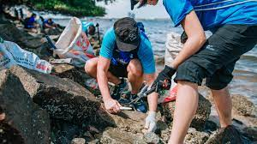
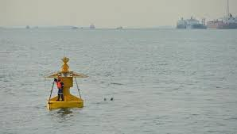

- The National Environmental Agency (NEA) main purpose is to ensure a clean and sustainable environment for Singapore.
- NEA current policy is to monitor Singapore’s water quality for any physical and chemical pollutants.
- The main method of clearing up pollutants is by using volunteers to pick them up once they are washed onto shore.

Slide 6
Resulting Problem
2
Notes:
YT

Slide 7
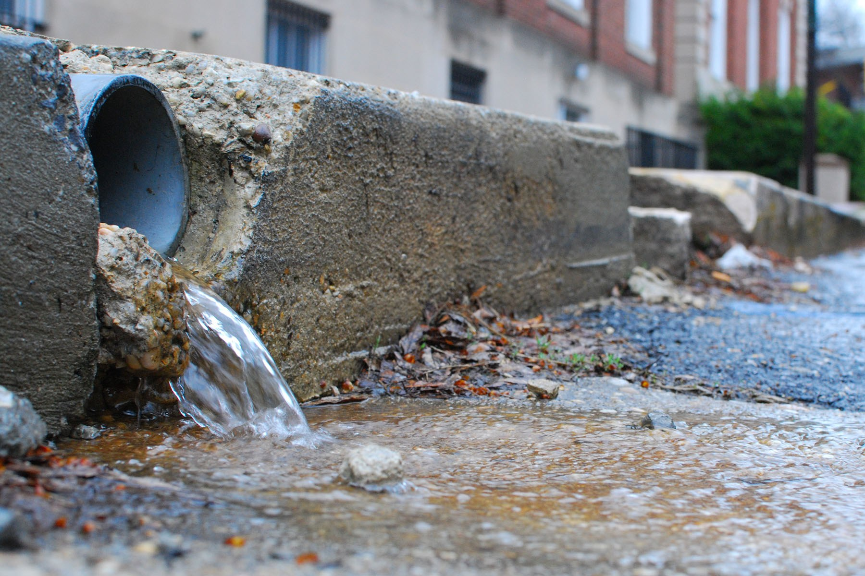
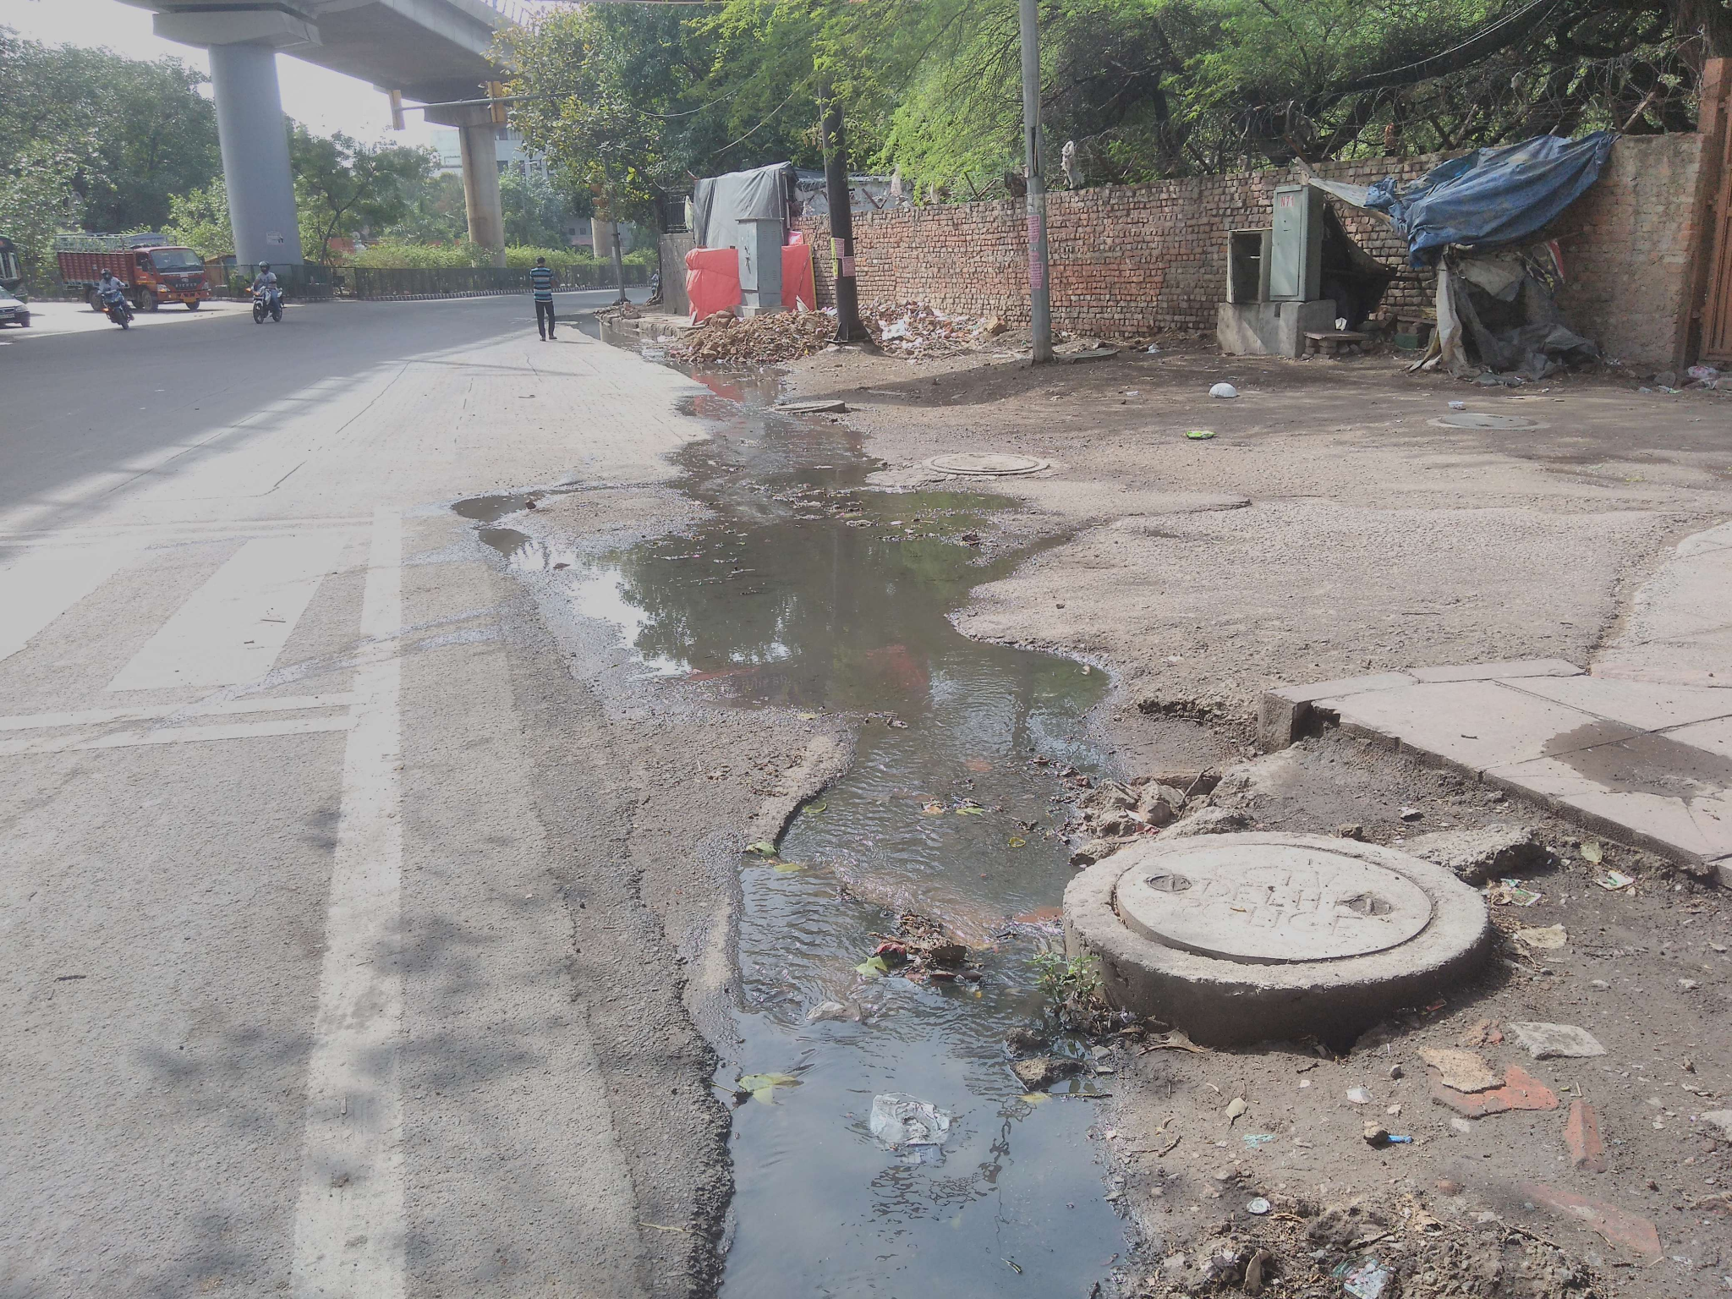
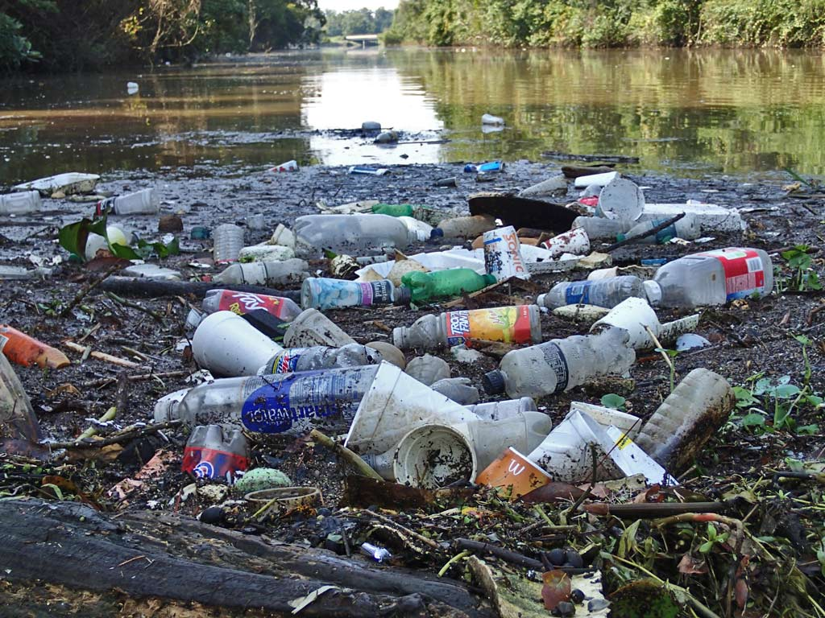
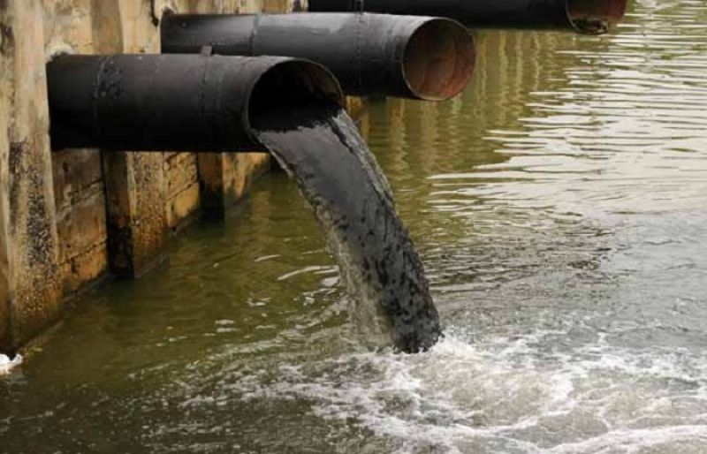
Resulting problem : Causes
Common Causes of Plastic Pollution Main causes for ocean plastic pollution:
Littering
illegal dumping
Plastic along coastlines gets hauled by the tides from littering
Other causes:
Urban and Stormwater runoff
Sewer overflows
Image sources: https://www.chesapeakebay.net/issues/threats-to-the-bay/stormwater-runoff https://timesofindia.indiatimes.com/citizen-reporter/stories/sewer-overflows-on-main-road/crshow/58903106.cms https://opelikaobserver.com/litter-an-ever-growing-problem/ https://www.suchtv.pk/pakistan/sindh/item/66584-factory-owners-illegally-dumping-industrial-waste-in-karachi-face-legal-action.html

Slide 8
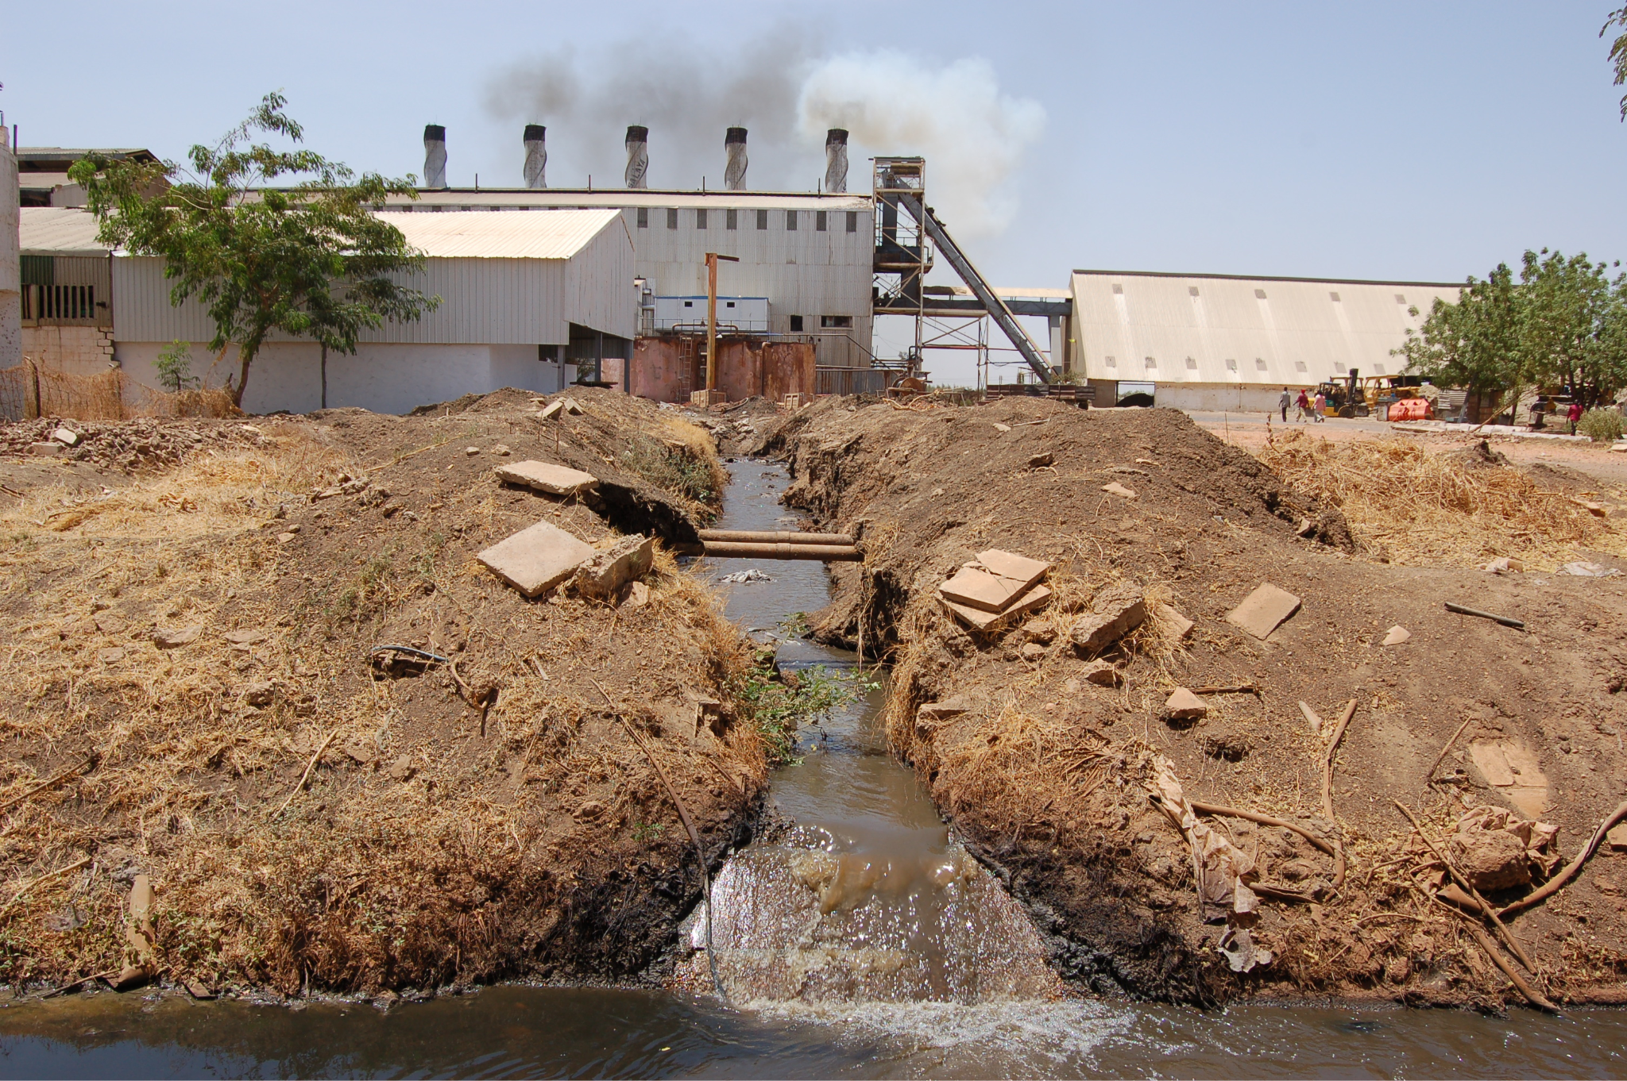
Resulting problem : Causes
How does plastic usage leads to pollution in the ocean?
Other causes:
Improper waste management
Industrial operations
Factors like intense weather and wind can lead plastic pollution into oceans.
Follows the current of water, ending up in oceans.
Image source: http://learn.e-limu.org/topic/view/?t=38&c=7

Slide 9
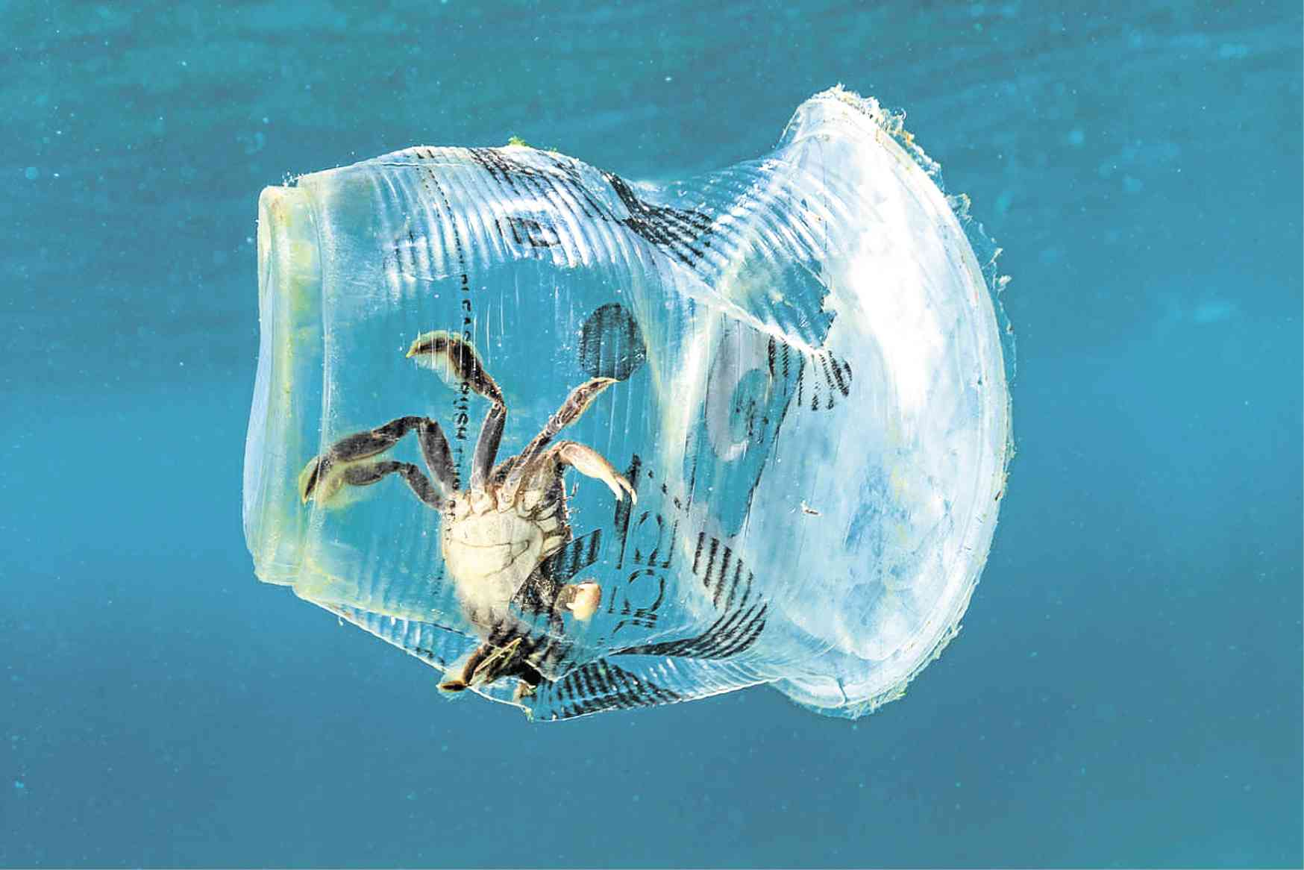
Resulting problem : Effect on Marine Life
>100,000 of Marine Life caught in plastic every year
Restricting food intake and movement
Colours and pattern of plastic waste resembles their prey.
Turtles, Fish and Whales
Algae and Bacteria collected in plastic debris.
Important source of protein and energy
Toxic compounds can be absorbed in plastic.
Gives false feeling of being “full”
Penetrates internal organs
Prone to starvation, illness or death
Image source: https://newsinfo.inquirer.net/1095506/ph-marine-life-center-not-spared-from-plastic

Slide 10
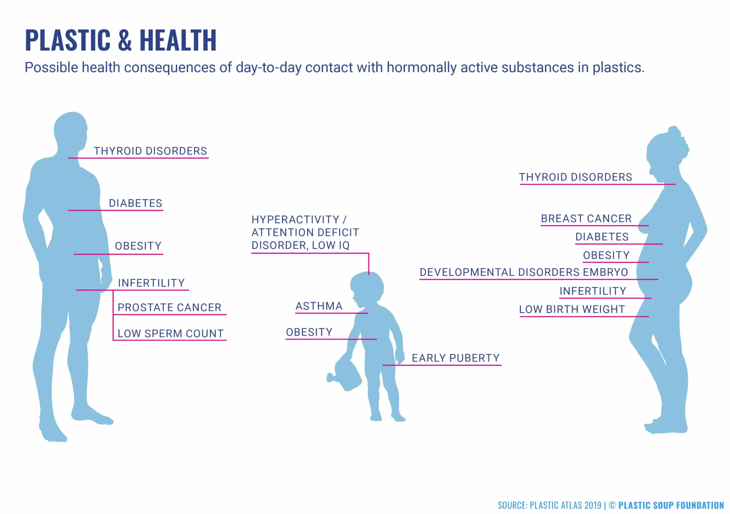
Resulting problem : Effect on Human Health
Problems caused by Plastic Pollution
Cancer
Heart problems
Childhood Development issues
Loss of important food source
Reduction in oxygen production
Image source: https://www.plasticsoupfoundation.org/wp-content/uploads/2021/06/PSF210607_infographics9-1-2048x1442.jpg
What do people really know and want to know about plastic & health? - Plastic Soup Foundation

Slide 11
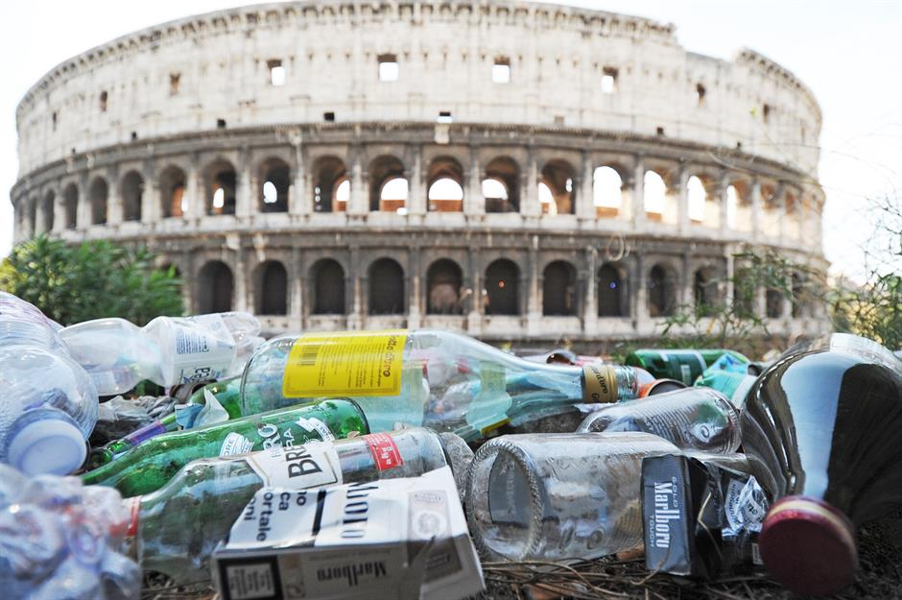
Resulting problem : Effect on Tourism
Problems caused by Plastic Pollution
Pollutes tourist spots
Less tourist visits
Decrease in revenue
Worsen Public Reputation
Decrease in revenue
Increase in job layoffs
Image sources: https://www.loveexploring.com/gallerylist/86221/amazing-tourist-destinations-being-ruined-by-trash

Slide 12
Solution
3

Slide 13
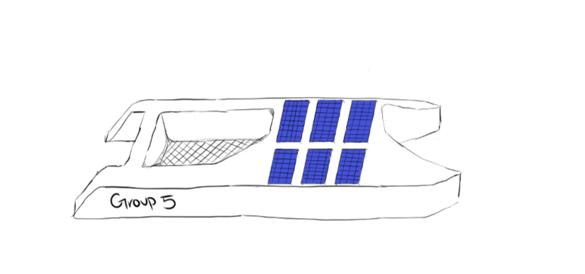
Solution
How does the unmanned miniature boat work?
Collects floating rubbish along the coastline.
Follows a predetermined path set by the National Environment Agency.
Returns to docking station for disposal of trash.
What if something happens to the boat?
A fail safe will be implemented to take remote control of the boat/Ocean Roomba.
Created and designed by: Yi Ting

Slide 14


Solution
How this benefits NEA
How Feasible is it
-Clear up shoreline more efficiently.
-Reduces ocean cleaning time, allowing priority for more important tasks.
-Gather data such as the type of plastic thrown.
Very likely: -Possible to code out the action and decision making process of the Roomba on scratch.
-Also allows for testing to be done on the robot’s code through the visual elements on scratch.
-However:
Not feasible to immediately implement this due to financial limitations.

Slide 15
Methodology
4

Slide 16

Methodology: Scratch
Why use Scratch software? Easy to implement simple tasks.
Does not require much knowledge of coding.
Has a “drag and drop” interface for basic functionality.
Enables collaboration across device platforms.
Makes it convenient for us to code anytime, anywhere.
Makes development process easier.
Allows access to all resources under one location.
In turn, these aspects helps to reduce the delivery timing of the solution.
Image source: https://www.youtube.com/channel/UCjcQmKeifVUUH5s4E4OrMhg

Slide 17
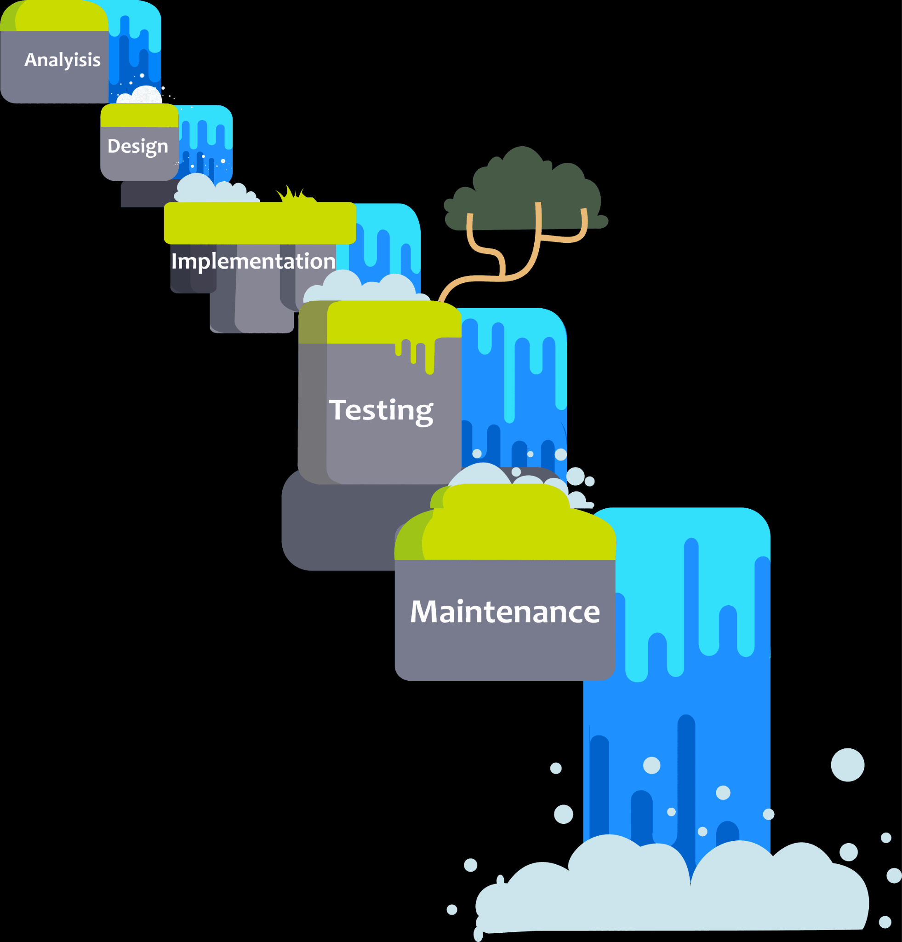
Methodology: Waterfall Approach
Why utilise Waterfall Approach? Plan the project timeline ahead.
Gives a clear direction of the project
Sets reasonable target setting for the project
Gives structure to the overall project.
Makes it stable when transitioning phases
Allows early detection of bugs.
Rectify issues much faster
All in all, this reduces misunderstandings among team members.
Image source: https://codingzap.com/waterfall-model/

Slide 18

Methodology: Information Gathering
What do we use to gather information? We source our data and information from relevant websites such as National Environmental Agency using search engines.
Why do we gather information? We could accurately design an effective solution to combat the plastic water pollution. This may include…
Functionality of the Robot
Additional Features
Improvements to the solution
Image source: https://www.vecteezy.com/vector-art/436840-vector-web-icon

Slide 19
References
5

Slide 20
References
Marine plastic pollution. (n.d.). IUCN. https://www.iucn.org/resources/issues-brief/marine-plastic-pollution
News Medical. (2019, June 19). Impact of plastics on human health and ecosystems. News-Medical.net. https://www.news-medical.net/news/20100320/Impact-of-plastics-on-human-health-and-ecosystems.aspx
Plastics in the Ocean Affecting Human Health. (n.d.). Case Studies. https://serc.carleton.edu/NAGTWorkshops/health/case_studies/plastics.html
The Economic Impacts of Marine Debris on Tourism-Dependent Communities | OR&R’s Marine Debris Program. (n.d.). https://marinedebris.noaa.gov/research/economic-impacts-marine-debris-tourism-dependent-communities
Witch, W. (2022, February 15). Why the travel and tourism industry need to combat plastic pollution. Water Witch. https://waterwitch.com/combating-plastic-pollution-in-the-ocean-sea-cleaner/
A., A. (2019, November 22). Why is marine life so important? – MassInitiative. https://massinitiative.org/why-is-marine-life-so-important/
WWF Singapore. (2022, April 4). Towards a plastic-lite Singapore. https://www.wwf.sg/plastics/

Slide 21
Thank you for listening!

Slide 22
QNA Session
6

